Slide 1
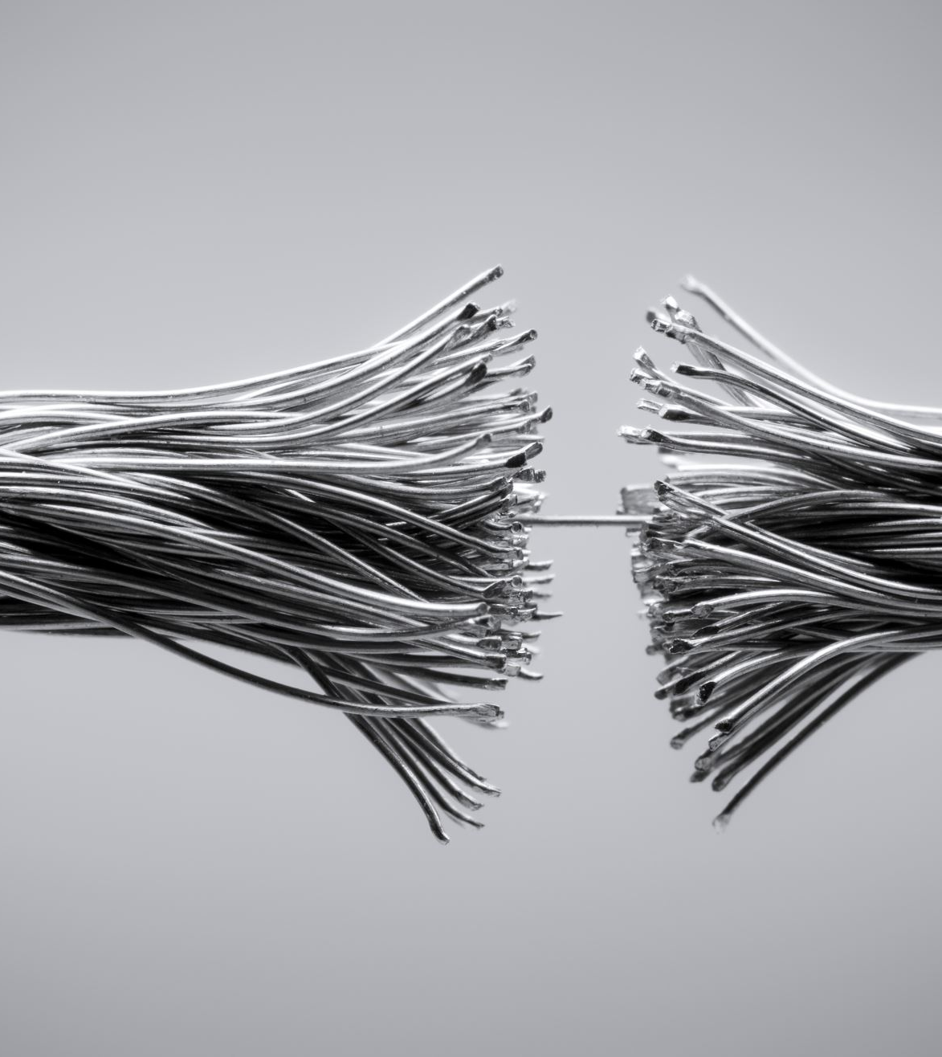
Automotive Wiring

Slide 2

‘KL’ is the abbreviation for ‘klemme’
which is the German term for connector/connection, or ‘Klemmenbezeichnungen’. Klemmenbezeichnungen means Terminal designations.

Slide 3
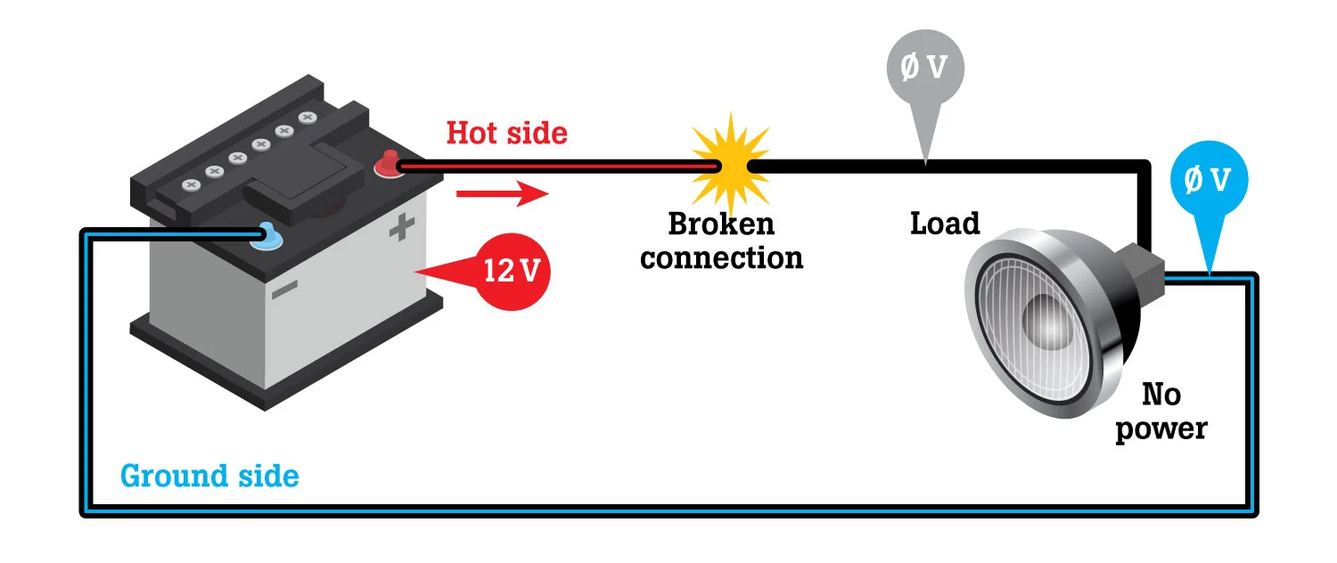
Power and Ground

Slide 4
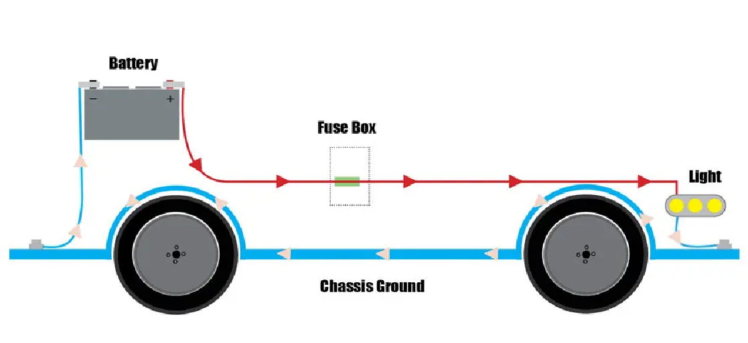
Simple Circuit

Slide 5
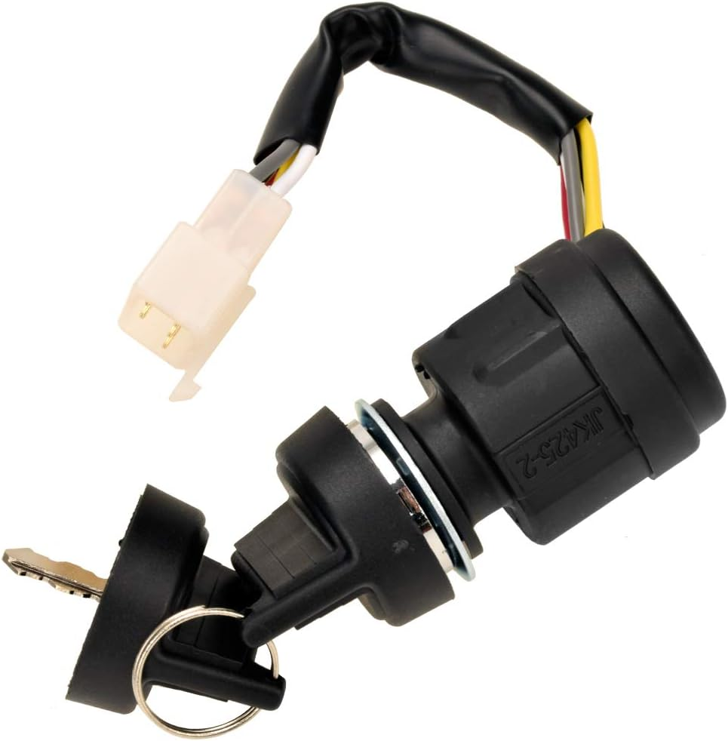
KL 15
Refers to the ignition-controlled power. This means that this circuit or power source is active when the ignition key is in the "ON" position. It provides power to components that need to be active only when the vehicle is either running or in the accessory position, such as the car radio, engine control unit, or air conditioning.

Slide 6
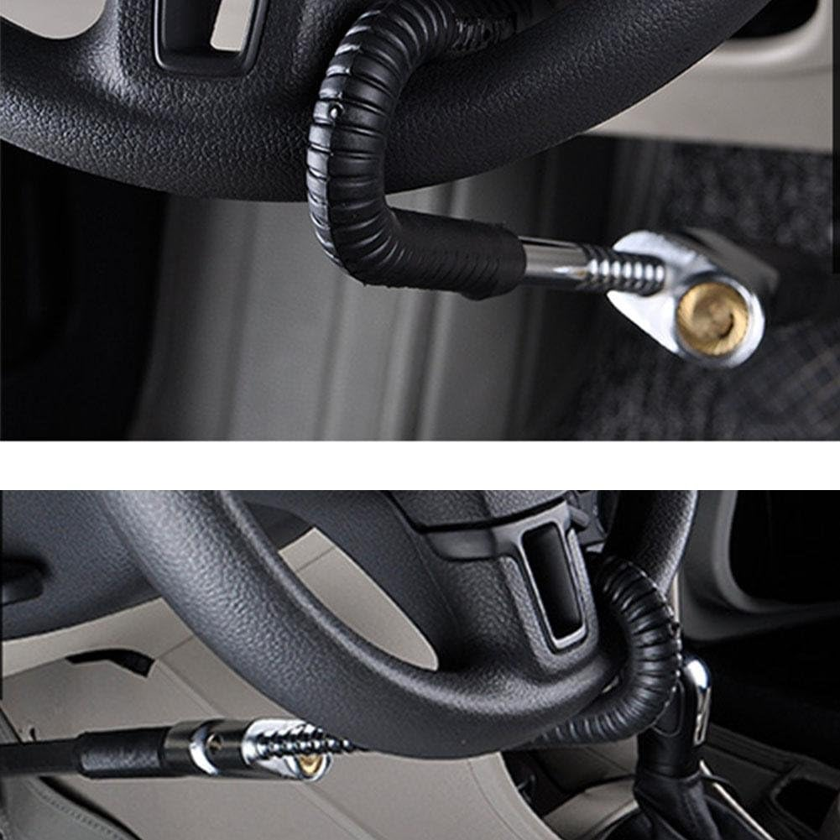
KL30
Represents the direct connection to the battery, meaning it provides constant power regardless of the ignition key position. This is the source for all components that need power even when the vehicle is turned off, like security systems, clock, or certain memory functions in modules.

Slide 7

Battery

Slide 8
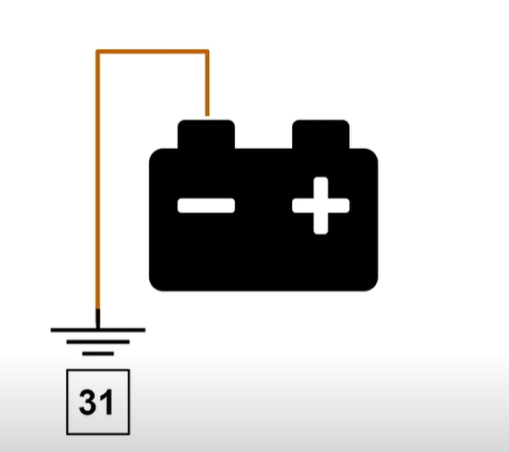
Terminal 31

Slide 9
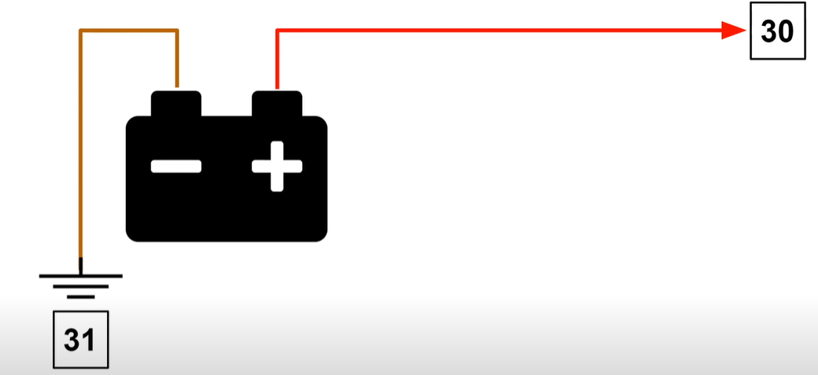
Terminal 31

Slide 10
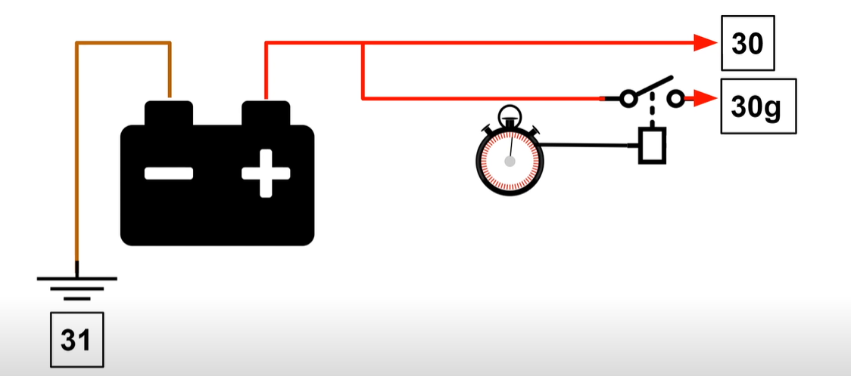
Terminal 30g

Slide 11
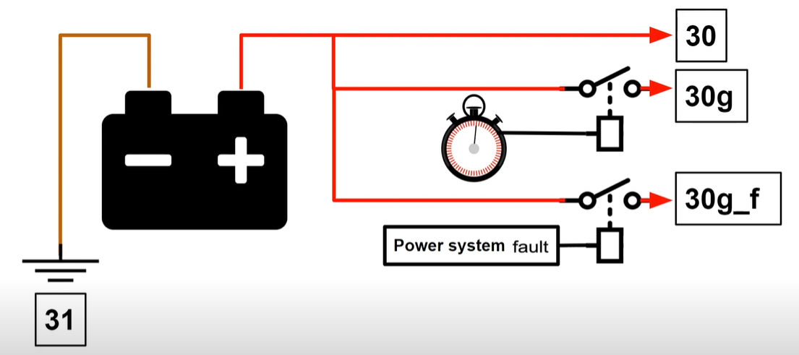
Terminal 30g_f

Slide 12
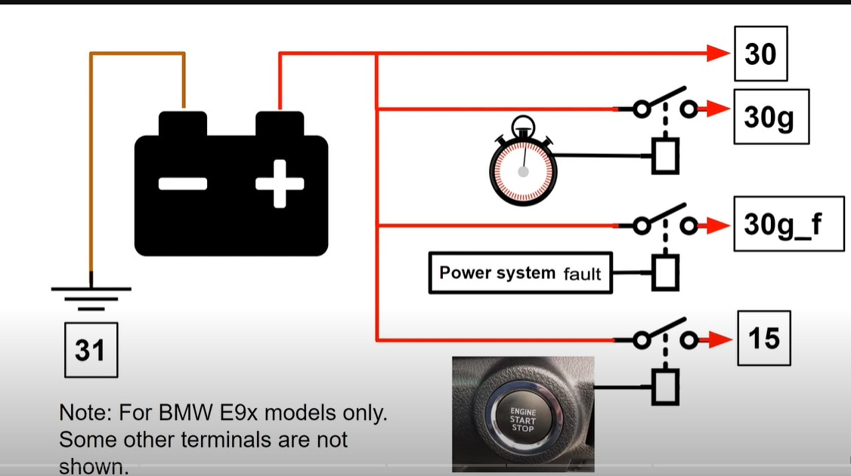
Terminals

Slide 13
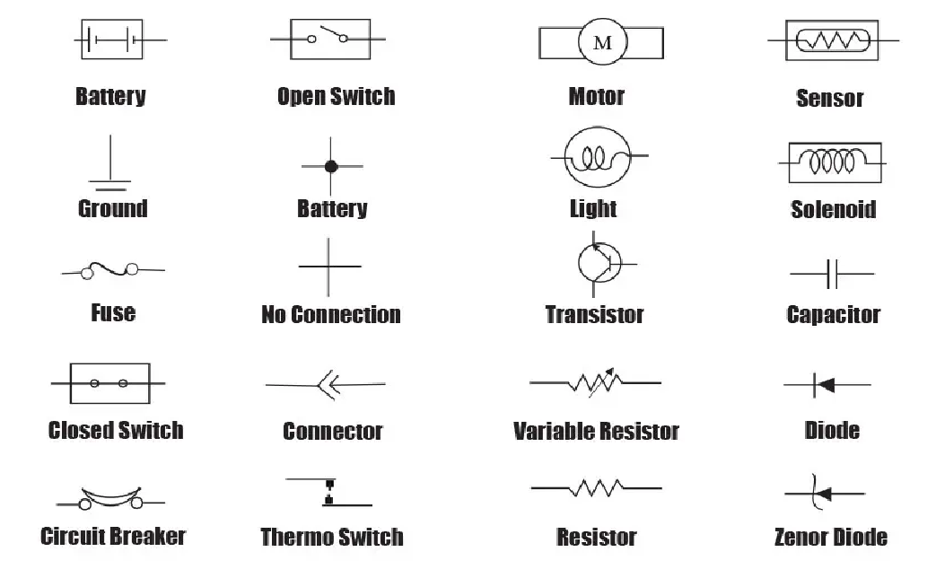
Symbols
Connected

Slide 14
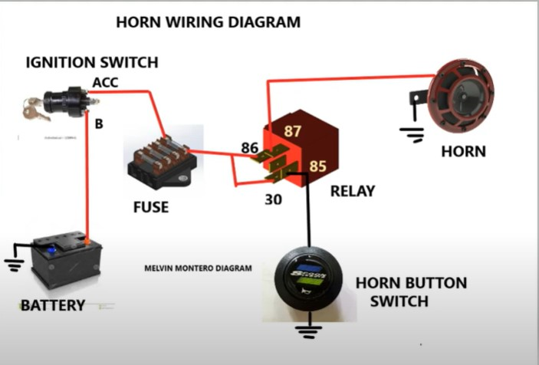
Horn Wiring Diagram

Slide 15
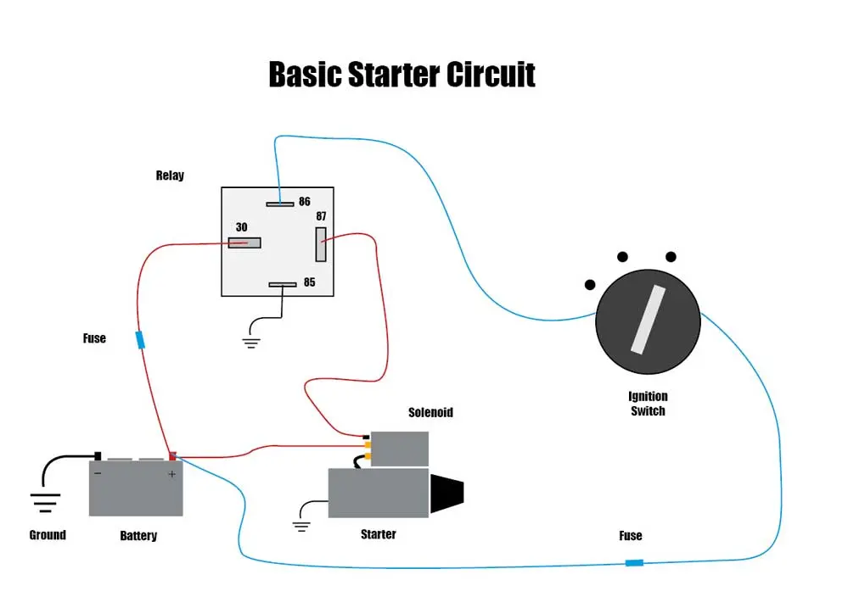
Basic Starter Circuit

Slide 16
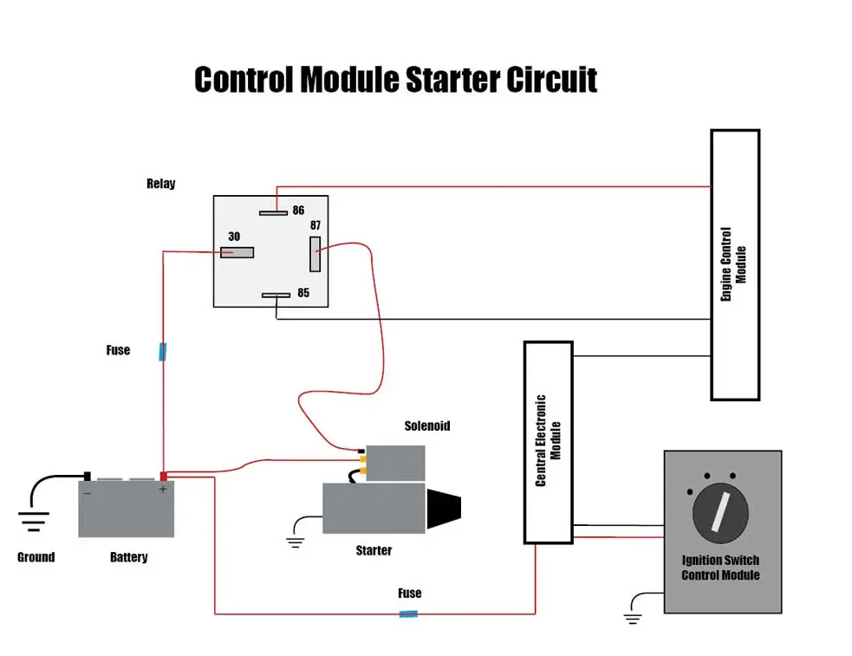
Control Module Starter Circuit

Slide 17
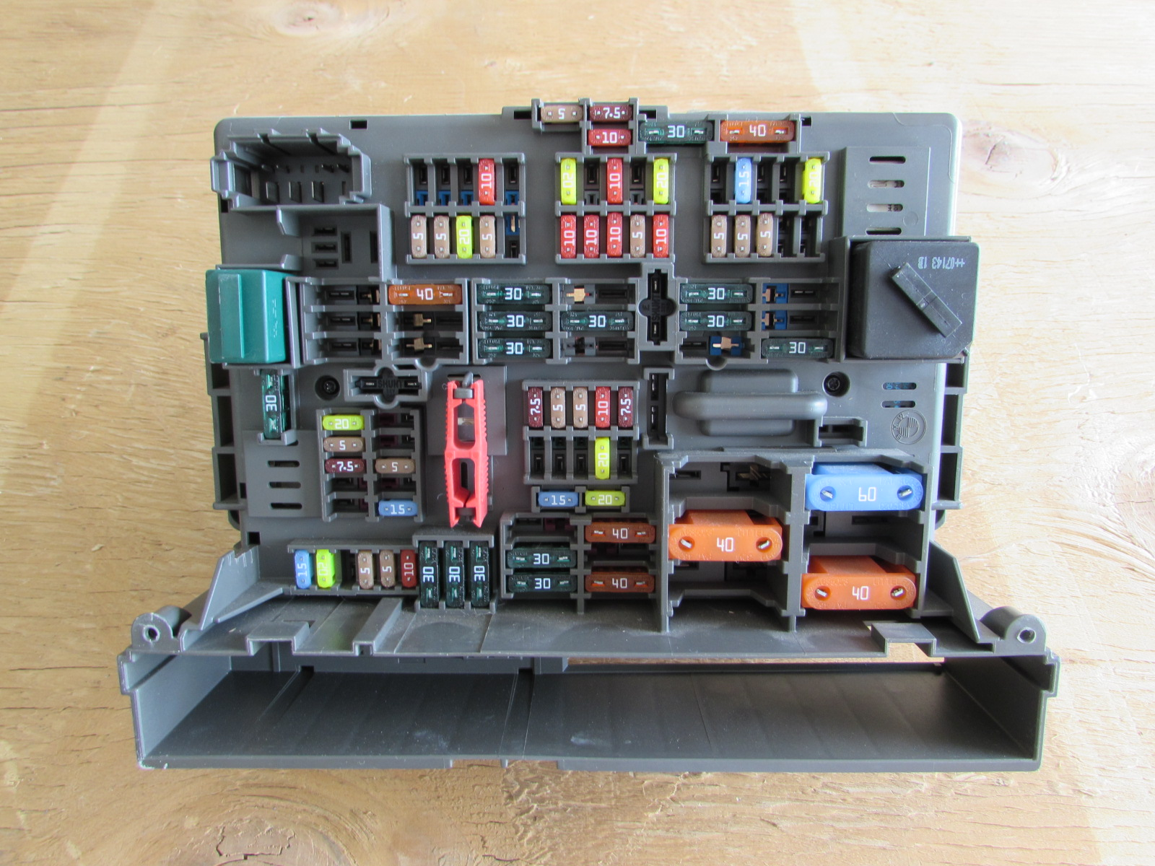
BMW Fuse Box

